Slide 1
Motors

Slide 2
Types of Motors
AC Motors
Synchronous
Asynchronous
DC Motors
Brushed dc
Brushless dc
Stepper motor

Slide 3
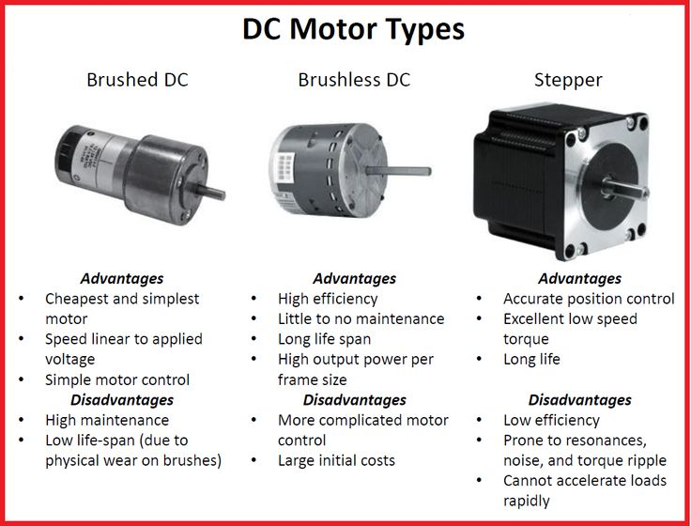

Slide 4
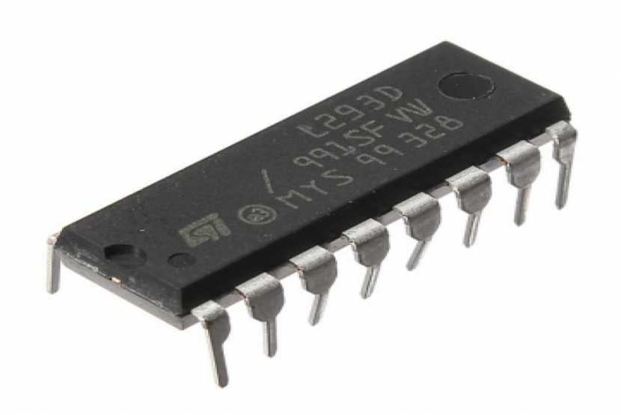
Motor Driver

Slide 5
What is a motor driver?
Integrated circuit chip which is usually used to control motors in robots.
Motor driver ICs act as an interface between microprocessors in robots and the motors in the robot.
The most commonly used motor driver IC’s are from the L293 series such as L293D, L293NE, etc.

Slide 6
Need of Motor Driver
Most microprocessors operate at low voltages and require a small amount of current to operate while the motors require a relatively higher voltages and current .
Thus current cannot be supplied to the motors from the microprocessor. This is the primary need for the motor driver IC.

Slide 7
L293D
16 pin IC
2 INPUT pins, 2 OUTPUT pins and 1 ENABLE pin for each motor.
L293D consist of two H-bridge.

Slide 8
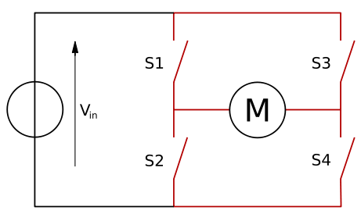
H-Bridge

Slide 9
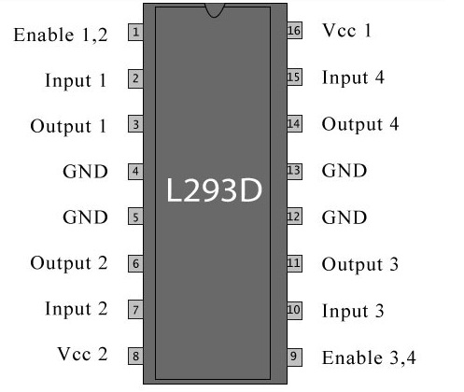

Slide 10
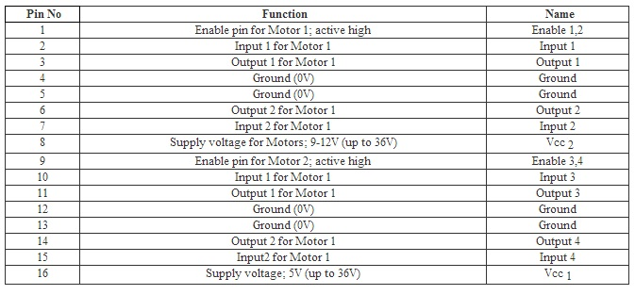

Slide 11
Wired Locomotion
DTMF (Dual Tone Multiple Frequency )
(robot operated) by using keypad of your mobile phone
Joystick
moves in all directions and controls the movement of a pointer or some other display symbol

Slide 12
DTMF
A system which consists of two frequencies superimposed.
DTMF decoder detects the DTMF tones and generates the binary sequence corresponding to key pressed in a DTMF keypad.
The sounds used for touch tone dialing are referred to as DTMF tones. Each number (as well as the "#" and "*") is represented by a pair of tones.

Slide 13
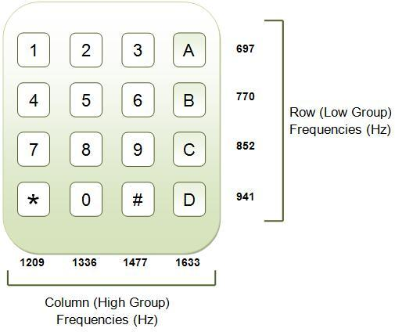
DTMF keypad is placed out on a 4 cross 4 matrices, in which each row represents low frequency, each column represents high frequency.
Each key you pressed on your phone generates two tones of specific frequencies. So that a voice can't imitate the tones.
DTMF tones are able to represent one of the 16 different states or symbols on the keypad.

Slide 14
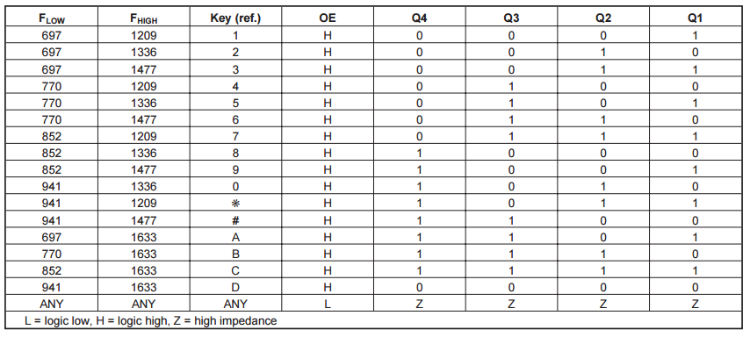
DTMF data output table :

Slide 15
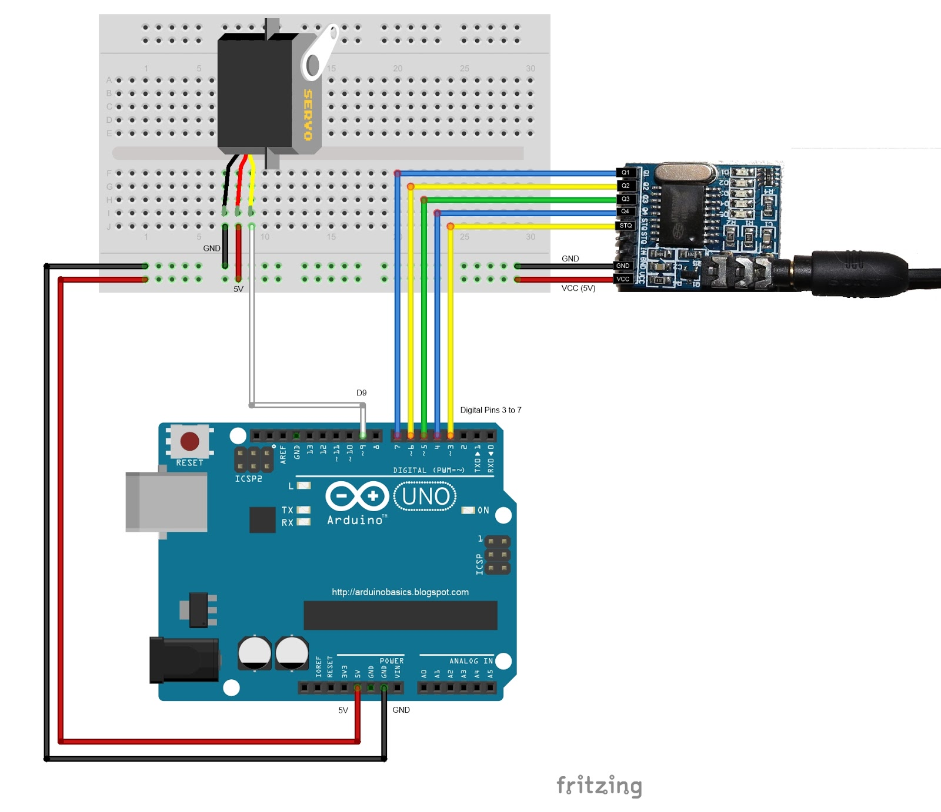

Slide 16
Once the DTMF module receives a DTMF signal, it will identify the relevant frequencies as described in the table, and produce a binary like output.
You will notice the DTMF module's on board LEDs light up when a tone is detected.

Slide 17
Application:
So you could use this module to alert when new emails or messages arrive on your phone or computer.
If you have the ability to change the email or message notification sound to a DTMF tone, you should be able to get the module and Arduino to respond accordingly.

Slide 18
Joystick
A joystick is an input device consisting of a stick that pivots on a base and reports its angle or direction to the device it is controlling.
They take something entirely physical -- the movement of your hand -- and translate it into something entirely mathematical -- a string of ones and zeros.

Slide 19
Types of Joysticks:
Digital joysticks (employing simply left, right, up, down and firing commands)
Paddle joysticks (consist on one knob used to control the game and one firing button)
Analog joysticks (combine both concepts presented in digital and paddle)
PC Analog joysticks (simple analog styled joystick with multiple buttons that usually connects via USB port)
Joypads (joysticks without the sticks)

Slide 20
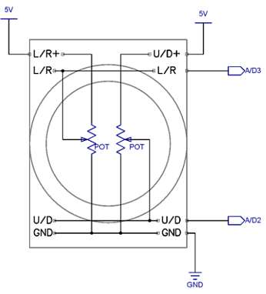
How this works…
The Analog Joystick is similar to two potentiometers connected together, one for the vertical movement i.e up and down (Y-axis) and other for the horizontal movement, left and right (X-axis).
Potentiometers are variable resistors and, in a way, they act as sensors providing us with a variable voltage depending on the rotation of the device around its shaft.

Slide 21
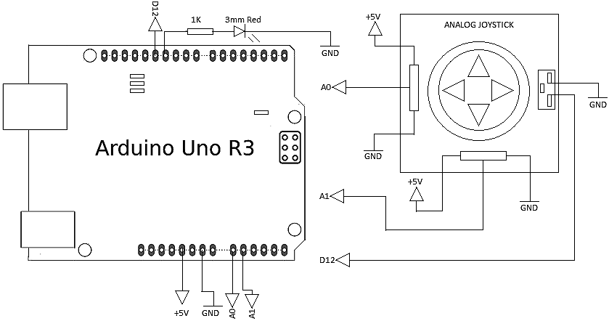

Slide 22
The Arduino Uno or any other Arduino board that uses Atmega328 as the Microcontroller has ADC resolution of 10 bits. Hence the values on each analog channel can vary from 0 to 1023.
The home position for the stick is at ( x,y:511,511). If the stick is moved on X axis from one end to the other, the X values will change from 0 to 1023 and similar thing happens when moved along the Y axis.

Slide 23
